Slide 1
MAR 530: Ecosystem Based Fisheries Management
Lecture 10
Socioeconomic considerations for EBFM
www.mycourses.umassd.edu
10 April 2015

Slide 2
Last Time…
Integrated Ecosystem Assessments
Risk Assessment

Slide 3
Today’s Outline
People are important in a fishery…
Economic considerations
Social considerations
Discussion on:
Endter-Wada et al. 1998
Branch et al. 2006
Fulton et al. 2011

Slide 4
One Main Theme Throughout Course
CONFRONTING TRADEOFFS

Slide 5
Simplified Schedule
Week | Theme | Topic
1/30 | Context | Introduction, What is EBFM?
2/6 |  | Challenges facing fisheries, what can EBFM offer?
2/13 |  | Guest lecture: case studies of EBFM
2/20 |  | Types of advice, decision theories, goal-setting
2/27 | Operational | Bycatch, habitat, and spatial management
3/6 |  | Ecosystem indicators
3/13 |  | Extended single-species and multispecies models
3/20 |  | SPRING BREAK
3/27 |  | Aggregate and system models
4/3 |  | Ecological risk assessment
4/10 | Institutional | Societal and economic considerations
4/17 |  | Governance and management institutions
4/24 | Holistic | Evaluating tradeoffs
5/1 |  | Moving towards ecosystem based management
5/8 |  | Final exam: Project Presentations

Slide 6
Managing fisheries is managing people
(Hilborn 2007)
Disciplines point to different solutions.
Ecologists may argue for networks of marine protected areas.
Economists argue for market-based mechanisms.
Sociologists argue for community-based management.
Policy makers/lawyers support stronger legal and institutional control.

Slide 7
People in fisheries
Fishers
Fish Processors
Consumers
Conservation groups
Fisheries law enforcers
Fisheries scientists
Fisheries Managers
Policymakers
Notes:
Are as varied as the fish they catch
Use a variety of gear and vessels to prosecute a fishery
Note sectors, fleets, coops, corporations, etc.
Have a wide range of motives and incentives to fish
Are excellent natural history observers
People who eat fish
Justify catching fish
Can provide a strong market incentive to modify fisher and processor behaviour
e.g. Eco-Labeling Certified Fish, Taste Preferences, etc.
Pointy-headed geeks who study a wide range of issues associated with fish in a scientific manner
Often involve monitoring, research, and analysis

Slide 8
Fisheries Managers
Need to address these considerations:
Economic – i.e. $$$
Religious
Historical
Cultural
Sociological - e.g. jobs
Anthropological
Legal
Biological
Political – see $$$ and jobs, power

Slide 9
Fishery
Management
Economic
Considerations
Social
Considerations
Conservation
Requirements

Slide 10



Link’s Three Pillars
1. Goal Setting (Priorities & Allocation of Biomass)
2. Assessing [Ecosystem] Status (Multivariate metrics)
Socio-economics needs to be explicit
3. Achieving [Ecosystem] Goals (Management Tools)
Biological emphasis

Slide 11
Socio-economic considerations for EBFM
Could easily take up a whole course (or several)
Plug for Marine Resource Economics
(Georgianna & Walden)

Slide 12
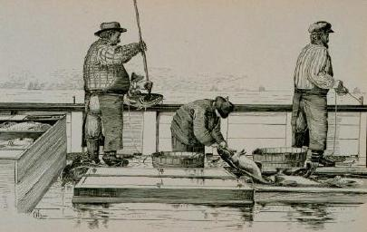
Economic considerations for EBFM
Ownership
Who owns the vessels in the fleet?
Who owns the resource in the ocean?
Who owns access to the resource?
Who owns the ecosystem supporting the targeted resource?
Hot topics/ issues:
* ‘Tragedy of the commons’
* Catch shares (Individual Transferable Quotas)

Slide 13
Economic considerations for EBFM
Value
What is the value of vessels, gear, equipment, etc. in the fleet?
What is the value of the resource in the ocean, caught, and landed?
What is the value of access to the resource?
What is the value of the ecosystem (goods and services) supporting the targeted resource?

Slide 14
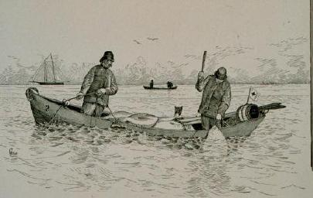
Economic considerations for EBFM
Value
What is the value of the resource in the ocean, caught, and landed? OK…
What are the market forces and dynamics that influence the value of a resource?

Slide 15
Economic considerations for EBFM
Value
What is the value of the ecosystem (goods and services) supporting the targeted resource? OK…
How do you calculate such valuation schemes?
Valuation of Ecosystem Services
Non-monetary valuation as well as $$$
Willingness to pay
Stated preference & Implied preference

Slide 16
Economic considerations for EBFM
Cost
What is the cost of vessels, gear, equipment, etc. in the fleet?
What is the cost of fuel to catch the resources?
What is the cost to the buyers, processors and suppliers to get the catch to the market?

Slide 17
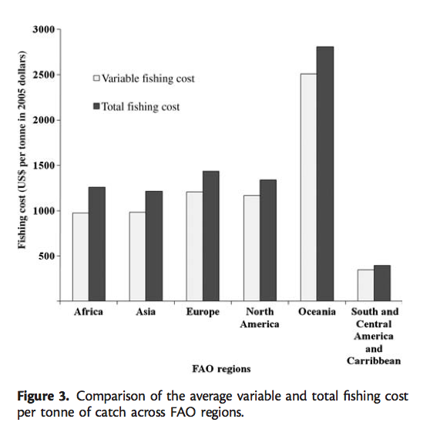
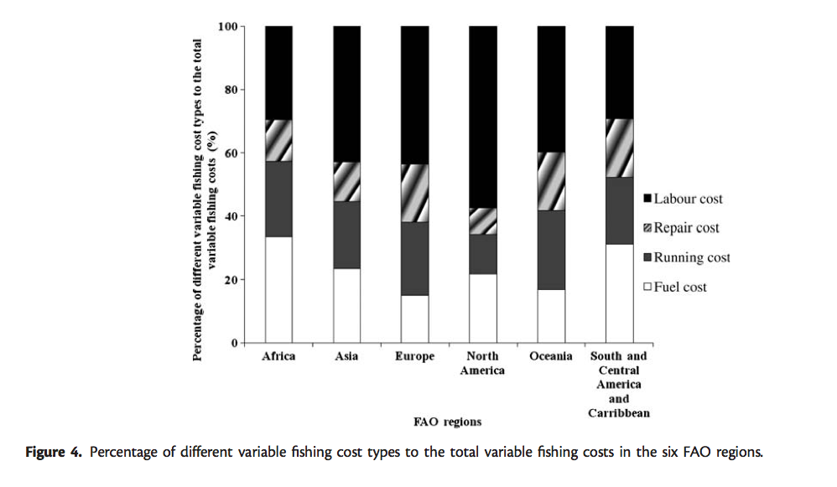
Lam, V. W. Y. et al. 2011. ICES Journal of Marine Science, 68: 1996–2004.

Slide 18
Economic considerations for EBFM
Cost
What is the cost to the resource in the ocean?
What is the cost to the ecosystem (goods and services) supporting the targeted resource?
How much foregone yield is there due to overfishing, bycatch, etc.?
Tradeoff analysis, perhaps using bioeconomic modeling approaches

Slide 19
Economic considerations for EBFM
Fleet Dynamics
What are the operational costs to the fleet?
What are the regulatory and enforcement costs to the fleet?
What are the logistical factors facing the fleet on a broad time scale (e.g. distance to fish, fishing ground hazards/hangs/snags, weather delays, etc.)?
What are the ecosystem considerations influencing where a fleet fishes?

Slide 20
Economic considerations for EBFM
Optimality
When, where, and what is the optimal amount of resource, and resource species mix, to catch that balances:
A minimization of cost
A minimization of deleterious ecosystem effects
A maximization of profit
Optimization schemes are a challenge.
Can we expect that people behave optimally?
Should we given our uncertainty?

Slide 21
Economic considerations for EBFM
Risk
When, where, and what is the appropriate amount of resource, and resource species mix, to catch that balances:
A maximization of limiting deleterious ecosystem effects
A minimization of losing profit
In such a manner that accounts for risk. (formal Risk Assessments helpful)

Slide 22
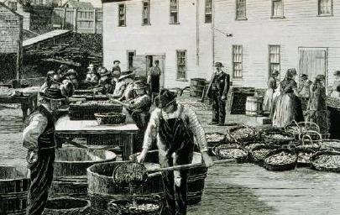
Economic considerations for EBFM
Incentives – understanding drivers of behavior
What motivates fishers to fish?
What motivates fishers to fish in different locales, using different gears, targeting different spp., at different rates, etc.
What motivates fishers to behave in certain ways that are risk prone, averse or neutral?
Ask the same questions of fisheries managers

Slide 23
Economic considerations for EBFM
Incentives
What incentives are there for fishers (and fisheries managers) to be precautionary?
…to be conservative with respect to catch?
…to account for ecosystem considerations?
Some argue that market-based schemes designed to create incentives are the most effective solutions.

Slide 24
Economic considerations for EBFM
Subsidies
How much of a fishery is ultimately subsidized (beyond market considerations) by government assistance?
Mostly all are to some degree
How much of fisheries science is subsidized beyond a fraction of the total value of a fishery and/or its supporting ecosystem?
How much does it cost to execute the management process?

Slide 25
Portfolio theory
Portfolio approaches to asset management assess the tradeoff between expected risk (variance) and return, where return on the portfolio (lP) is the sum of total available returns on each asset.
(Halpern et al. 2011)
Or, “Don’t put all your eggs in one basket.”

Slide 26
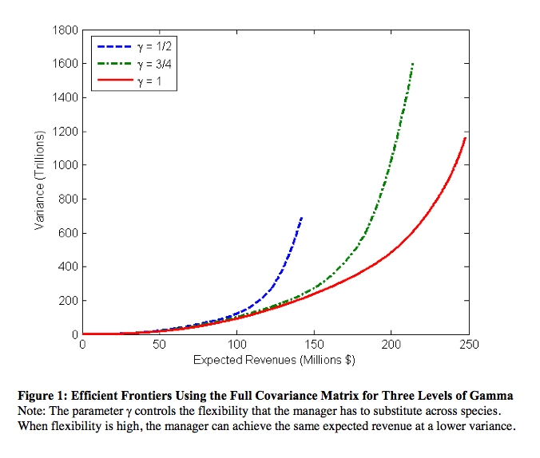
Portfolio theory: flexibility in species substitution can decrease variance in revenue (Sanchirico et al. 2005)

Slide 27
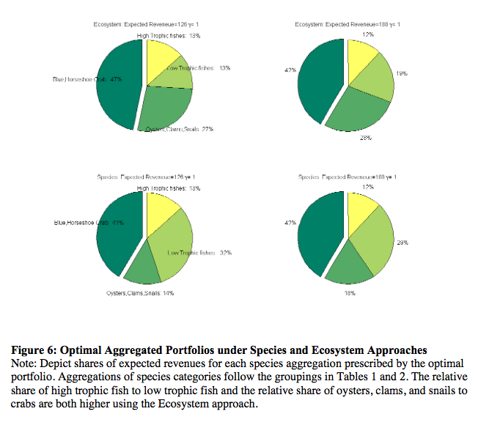

Slide 28
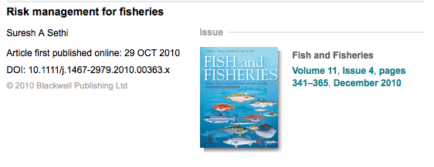

Some excellent papers on this subject

Slide 29
Economic considerations for EBFM
Summary
Economics is more than just $$$ (it’s really about human behavior)
Some of the key observations is to take a “portfolio” approach.
Ecosystem valuation is a BIG topic.
Need to incorporate ecosystem considerations in discussions of economics.
Need to incorporate economics in discussions of ecosystem management.

Slide 30
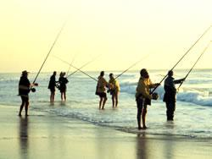
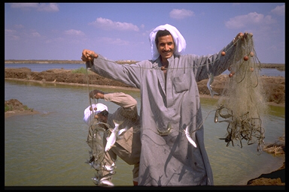
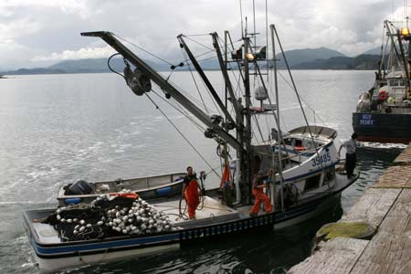
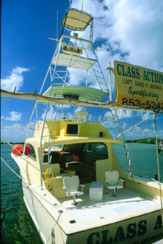

Societal considerations for EBFM
What kind of a fishery is it?
Commercial
Recreational
Artisanal

Slide 31
Societal considerations for EBFM
Culture
How much of the local history is based off of fishing?
How much of a local/regional economy is supported by fishing (as a % of total)?
How much of a community’s or large group of individual’s identity is based off of fishing or a fishery?
How (much) does the local geography, institutions (and names thereof), art, cultural expressions, etc. depict fishing?
e.g., we have Cape Cod, not Cape Sculpin

Slide 32
Societal considerations for EBFM
Employment
How many jobs in a locality/region are based off of fishing?
Directly as fishers, buyers
Indirectly as processors, middlemen, consultants, managers
What other employment options are available?
Is entering the fishery sector a viable employment option?

Slide 33
Societal considerations for EBFM
Power
Managing (some would say controlling) fisheries influences where a lot of money and jobs go.
Where does the power in a fishery reside?
Fishers, processors, managers, conservationists, consumers, enforcement?
Clue, it’s not usually scientists
Which individuals in the entire fishery are key players?

Slide 34
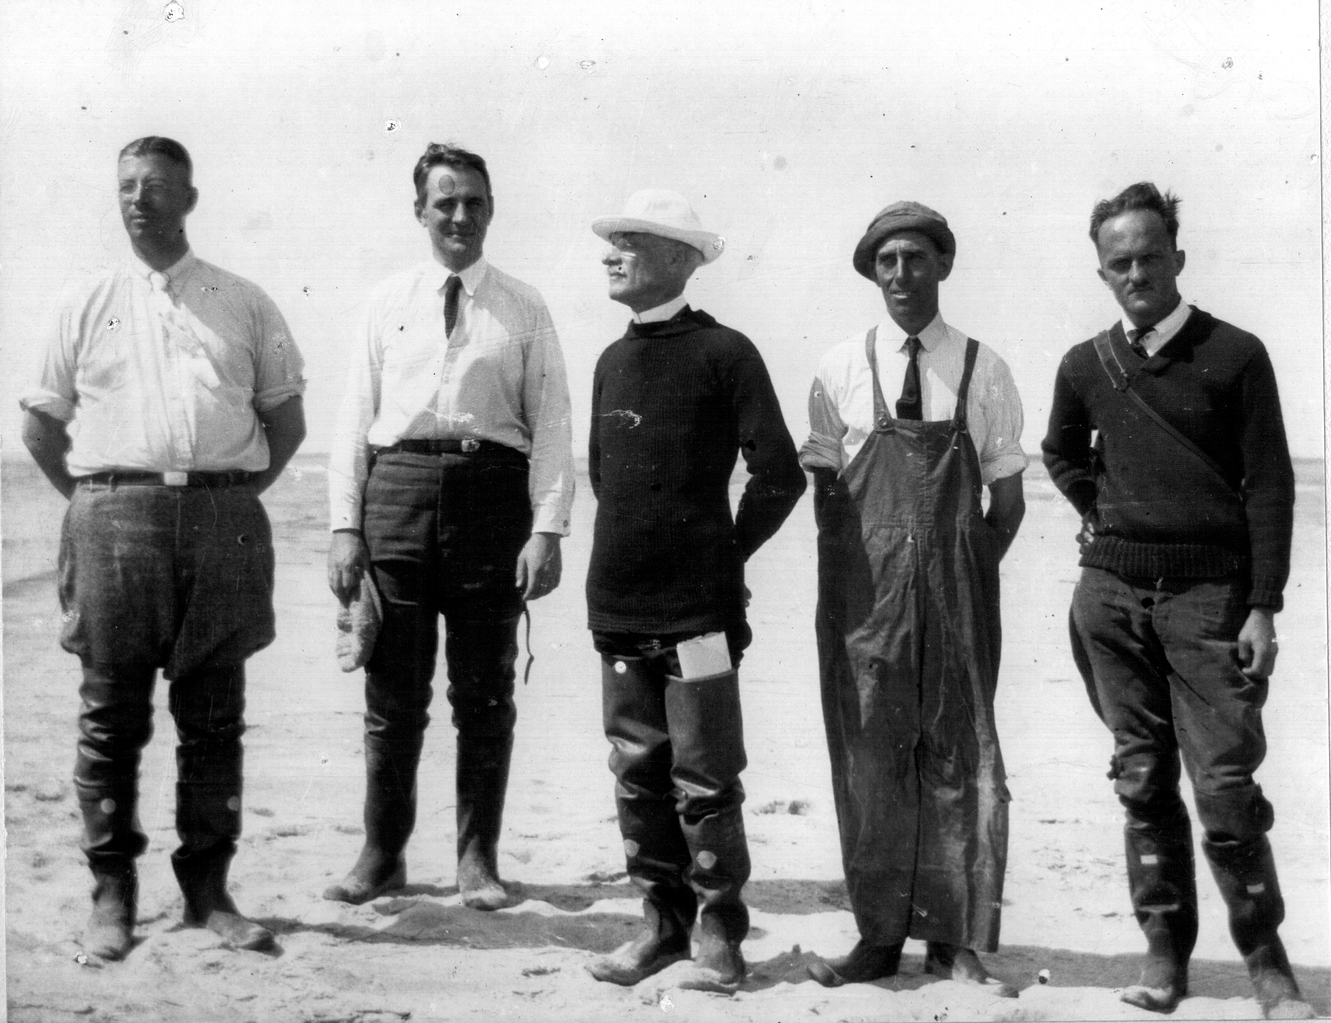
Societal considerations for EBFM
Worldview
What is the social ethos with respect to resource harvesting?
… ecosystem considerations?
What is the mix of stakeholders in a region?

Slide 35
Use of societal indicators for EBFM
Societal information has historically been tacked on to the end of process, rather than integrative.
Consequently, a focus on societal impacts, rather than societal factors as drivers.
Indicators other than employment are coming online.

Slide 36
Radar graphs
Social Indicators of Fishing Community Vulnerability and Resilience
Jepson and Jepson (2013) NOAA Tech. Memo. NMFS-F/SPO-129

Slide 37
Use of societal indicators for EBFM
Societal information has historically been tacked on to the end of process, rather than integrative.
Consequently, a focus on societal impacts, rather than societal factors as drivers.
Indicators other than employment are coming online.
Societal information being used to evaluate the effectiveness of programs designed to create incentives for fisheries management (e.g. catch shares).
Social network theory being applied to evaluate how decisions are made within communities, identify actors of influence, fishing choices, etc.

Slide 38
Societal considerations for EBFM
Summary
May be difficult to quantitatively add societal considerations into Ecosystem Models.
But there are still some quantitative methods and indicators.
However, knowledge of these factors still needed in the overall EBFM process.
Valuable to have stakeholder input that accounts for broader human considerations.

Slide 39
Societal considerations for EBFM
Summary
Need to incorporate ecosystem considerations in discussions of social systems.
Need to incorporate societal considerations in discussions of ecosystem management.
These considerations are, in large part, where different tradeoffs (regarding objectives) arise.

Slide 40
What do we need?
INFORMATION:
More “survey” designs & applications.
RESEARCH:
How to do economic valuation of ecosystem “goods and services”.
More statistical relationships among economic drivers and social and/or biological responses.
PROCESS:
How to insert socio-economic considerations into the entire management process.
How to balance social, economic, and conservation/biological objectives?

Slide 41
Doing EBFM
Questions?

Slide 42
What’s Next?
Governance and Institutions
Discussion on:
Costanza et al. 1998
Gutierrez et al. 2011
Sainsbury et al. 2000
Sissenwine & Mace 2003

